Slide 1

Population and Sample in Statistics
Understanding population and sample is fundamental in statistics. It helps us draw inferences about a larger group from a smaller subset.
by Sree bhagavath P S
by Uppili Srinivasan P
By sanjaay pramoth R

Slide 2

Definition of Population
A population encompasses all individuals or elements that share a common characteristic of interest. This could be all residents of a city, all cars produced by a company, or all plants in a garden.
Complete Set
Common Characteristic
Represents the entire group of individuals or objects being studied.
All members of the population share a specific trait or attribute that makes them relevant to the research.

Slide 3

Definition of Sample
A sample is a subset of a population selected for study. This subset is chosen to represent the characteristics of the entire population.
Subset of Population
Representative
A smaller group selected from the larger population.
The sample should reflect the key characteristics of the population, ensuring it's a good representation.

Slide 4

Characteristics of a Good Sample
A good sample should accurately represent the population and allow for reliable conclusions to be drawn.
1
Representativeness
2
Randomness
Reflects the key characteristics of the population, ensuring the sample isn't biased.
Every individual in the population has an equal chance of being selected for the sample.
3
Sufficient Size
Large enough to provide a reasonable representation of the population, ensuring statistically significant results.

Slide 5
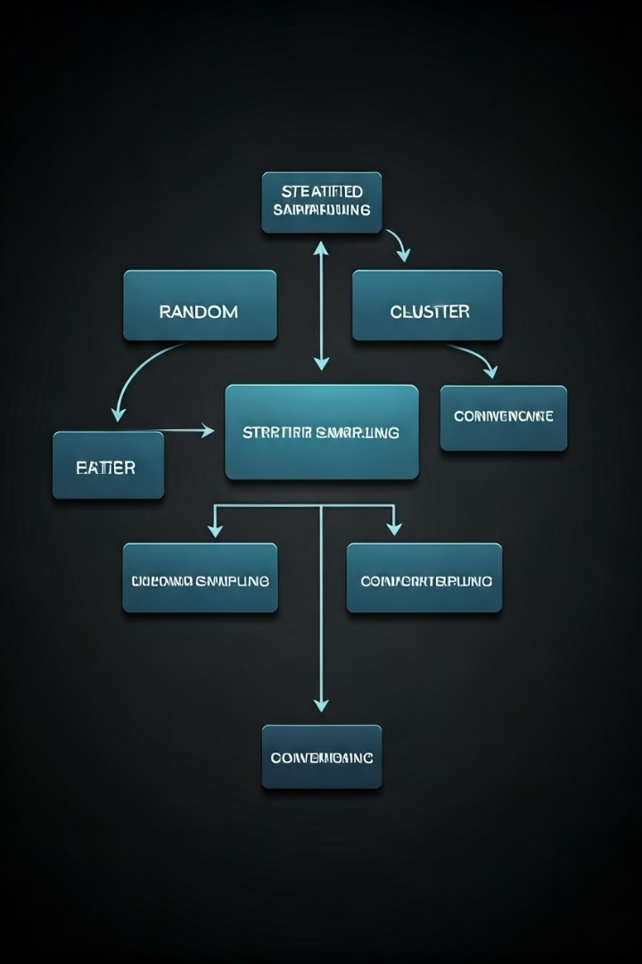
Sampling Methods
Sampling methods determine how a sample is selected from the population. These methods can vary depending on the research objectives and the characteristics of the population.
1
Simple Random Sampling
Each individual has an equal chance of being selected.
2
Stratified Sampling
The population is divided into subgroups based on relevant characteristics, and then a sample is randomly selected from each subgroup.
3
Cluster Sampling
The population is divided into clusters, and then a random sample of clusters is selected, with all individuals in the selected clusters being included in the sample.
4
Convenience Sampling
Individuals are selected based on their availability and ease of access.

Slide 6
Advantages of Sampling
Sampling offers several advantages over studying the entire population, making it a valuable tool in research.
Cost-Effective
Time-Saving
Feasibility
Sampling significantly reduces the cost of data collection compared to studying the entire population.
Sampling allows for quicker data collection and analysis, leading to faster research completion.
Studying the entire population might be impossible due to logistical challenges or resource limitations, making sampling a practical alternative.

Slide 7

Limitations of Sampling
Sampling can be subject to limitations that can affect the accuracy of the results and the generalizability of findings.
Sampling Error
The difference between the results obtained from the sample and the true value of the population.
Bias
The sample does not accurately reflect the population, leading to skewed results.
Limited Generalizability
Findings from the sample may not be applicable to the entire population.

Slide 8




Conclusion and Key Takeaways
Population and sample are essential concepts in statistics. Understanding their definitions, characteristics, and sampling methods allows us to draw accurate inferences about populations based on data collected from samples.
Population
The entire group of interest.
Sample
A subset representing the population.
Inference
Drawing conclusions about the population based on the sample.

